Slide 1

Brain Tumor Segmentation
OOP Lab
Group Name:
PythosLab
Group Members:
Aimal Khan (21WCSE1996)
Awais Saddiqui (21PWCSE1993)
Moeen Khan (21PWCSE2069)

Slide 2
Introduction:
Brain tumor segmentation is the process of identifying and isolating the region of the brain that is affected by a tumor. This is a crucial step in medical imaging analysis as it helps medical professionals to accurately diagnose and plan treatment for brain tumors. AI techniques, such as deep learning, have been widely used for brain tumor segmentation as they can automate the process and provide highly accurate results.
Dataset Used:
Dataset used in this project was provided by Jun Cheng.
This dataset contains 3064 T1-weighted contrast-enhanced
images with three kinds of brain tumor.
Each image is of dimension 512 x 512 x 1
Images are black and white images thus having a
single channel.

Slide 3
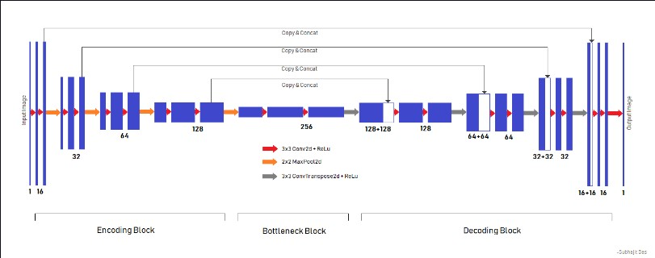
UNET Model:
UNET is a deep learning model architecture for image segmentation tasks, such as medical image segmentation, identifying objects in an image, or separating a background from the foreground.

Slide 4
OOP Used:
Inheritance:
In bts/loss code defines the DiceLoss class in PyTorch, which inherit(simple inheritance) the functionality of the PyTorch nn.Module class. The init method initializes the parent nn.Module class by calling the super method and passing in the class name DiceLoss as an argument. This allows the DiceLoss class to inherit all of the attributes and methods of the nn.Module class.
Classes and object:
We make four classes in bts file model,classifier,plot and dataset. And then initialized constructers of each class.Then import these files in api.py file and initialize objects of classes.
Encapsulation:
In bts/classifier uses the concept of encapsulation by creating objects of class BrainTumorClassifier
and using the methods of this class to perform different operations like training and testing the model .

Slide 5
Brain Tumor segmentation:
01
03
05
Data Collection
Model Design
Deployment
Data Preprocessing
04
02
Model Training

Slide 6
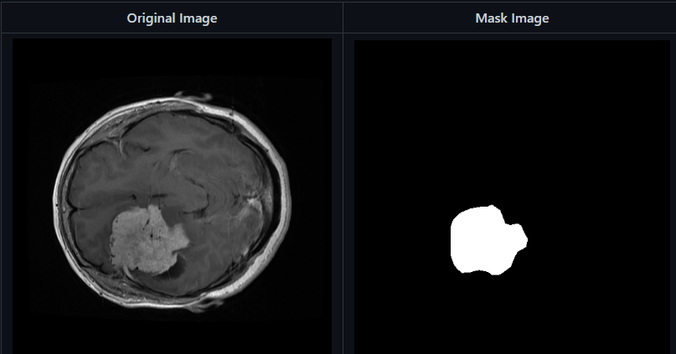
Output:

Slide 7
Application:
Diagnosis: Segmentation of brain tumors helps in accurate diagnosis of the type and extent of the tumor.
Surgical Planning: Segmentation helps neurosurgeons to plan the surgical procedure and determine the safest and most effective way to remove the tumor.
Radiation Therapy Planning: Accurate segmentation of tumors can help in planning the radiation therapy and ensuring that the maximum dose is delivered to the tumor while minimizing the exposure to healthy tissues.
Monitoring Tumor Growth: Segmentation can be used to track the growth of a brain tumor over time and monitor its progression.
Clinical Trials: Segmentation results can be used in clinical trials to evaluate the efficacy of new treatments for brain tumors.
References:
https://www.sciencedirect.com/science/article/abs/pii/S1361841516300330
https://medium.com/mlearning-ai/brain-tumor-segmentation-using-deep-learning-models-5047984b53c0
https://developer.nvidia.com/blog/automatically-segmenting-brain-tumors-with-ai/
https://chat.openai.com/

